Slide 1
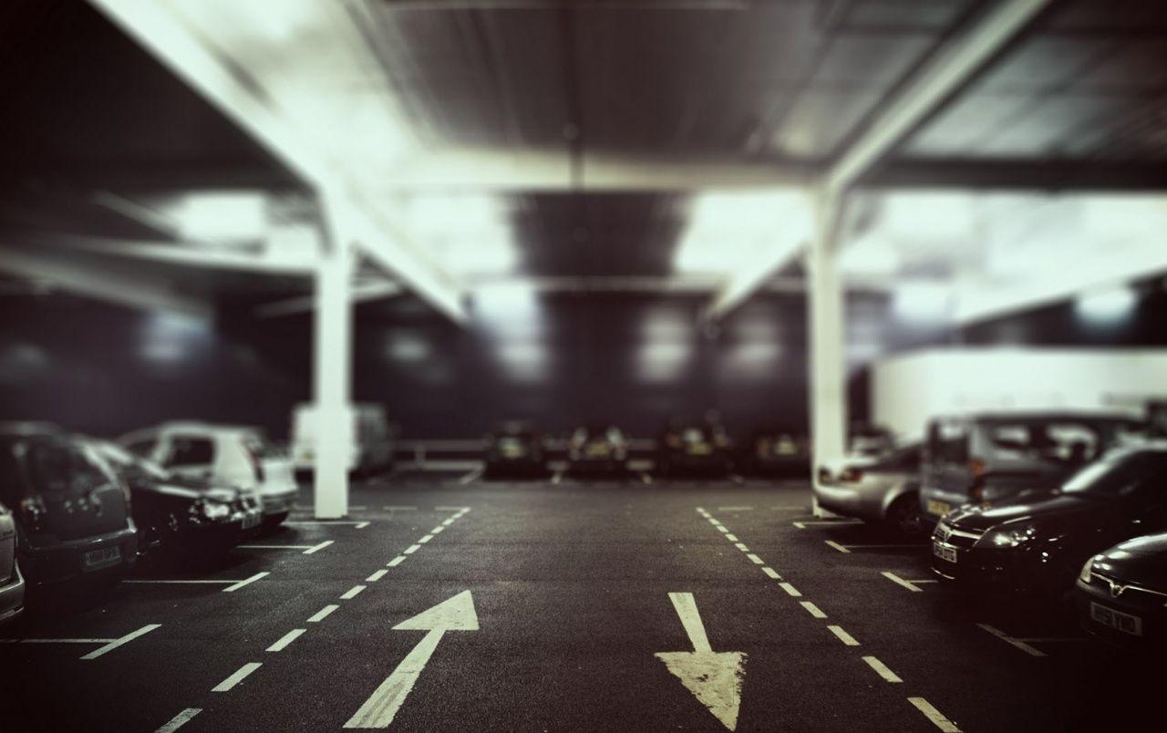
Online Parking System
Group no:43
Presented by
1091_Prachi Pradip Kendrekar
1050_Dhanshree Mohan Sangle

Slide 2
Contents
Abstract
Introduction
Objectives
Functionalities
Advantages and Disadvantages
Conclusion

Slide 3
Abstract
It offers a reservation system where user can view various parking
Spaces and select specific area of their choice to view whether
space is available or not.
If the booking space is available, then user can book it for specific time slot. User can also view previous parking booking details using the website.

Slide 4
Introduction
In Metropolitan areas , most vehicle drivers have the daily
concern of finding a vacant parking space especially
during Rush hours
Hence the proposed solution is Online Parking System
It offers a reservation system where user can view various parking spaces and select specific area of their choice to view whether space is available or not.
If the booking space is available, then user can book it for specific time slot.
User can also view previous parking booking details using the website.

Slide 5
Objectives
Providing Simple web application for reserving parking spaces
Can find parking spaces as per city , area and location
User can book parking spaces before arriving

Slide 6
Functionalities
Create new user
Login as user
Find parking as per city
Book parking space before arriving
Payment
View booking history of user
Login as Admin
Add parking locations

Slide 7
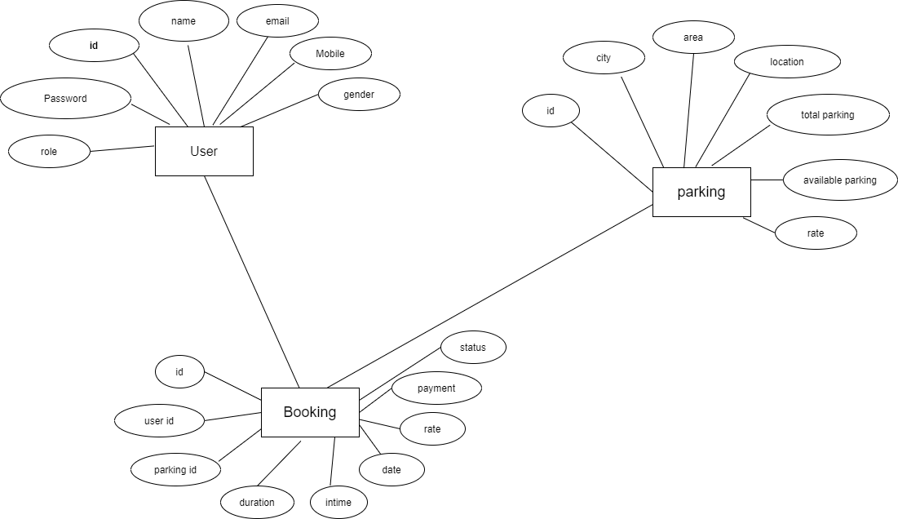
ER-Diagram

Slide 8
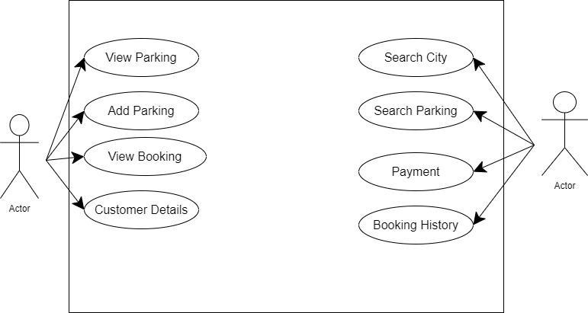
Usecase Diagram

Slide 9
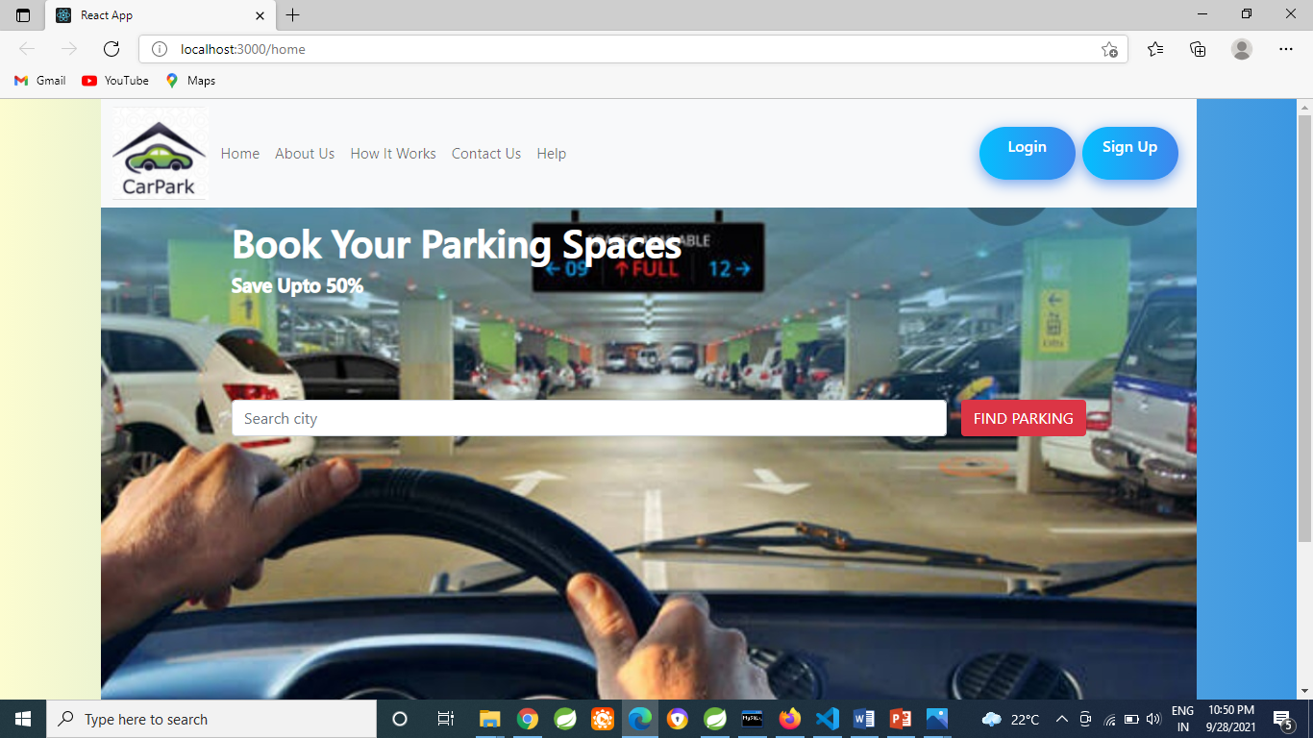

Slide 10
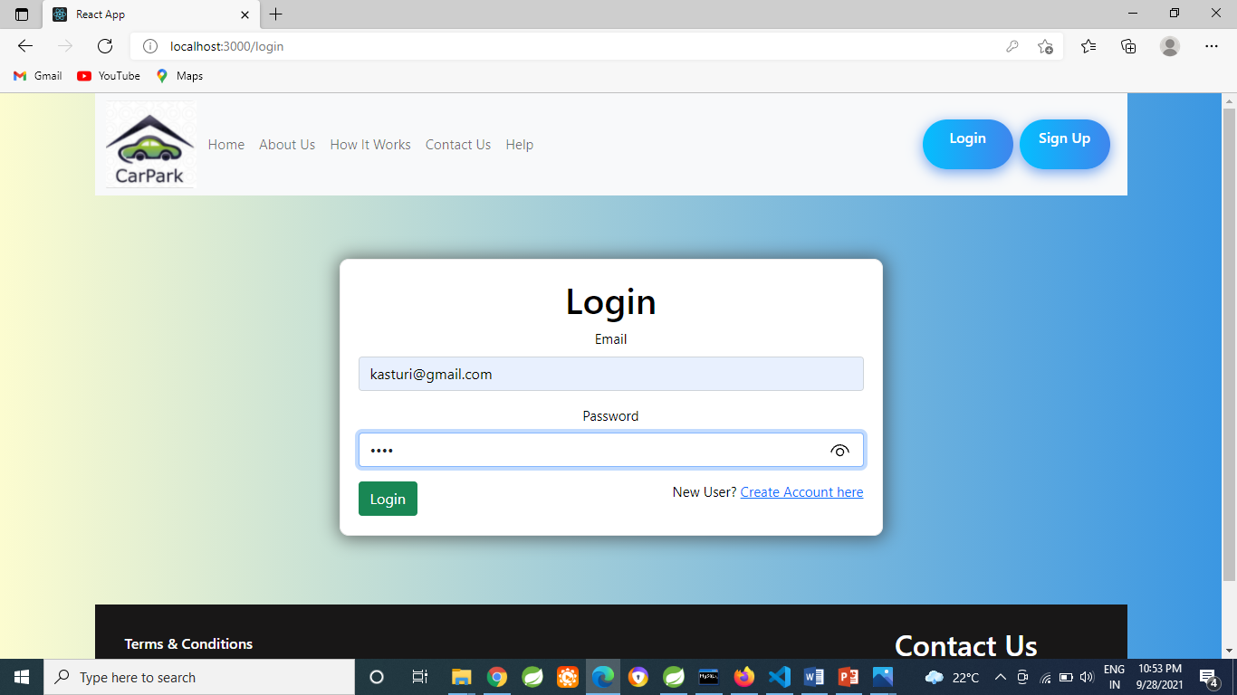
Login As a User

Slide 11
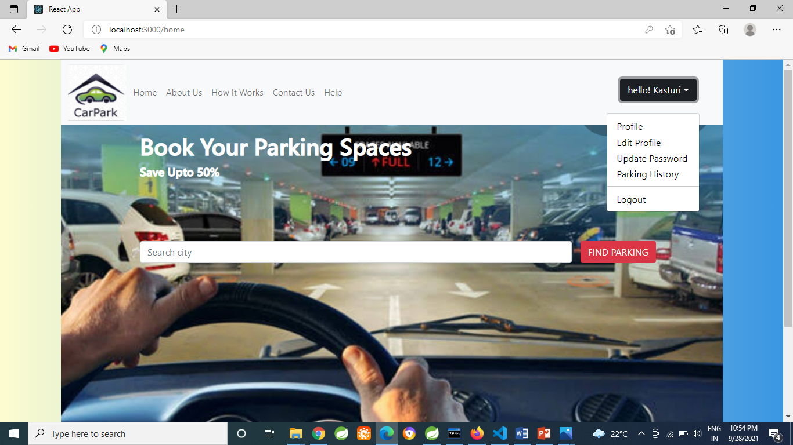

Slide 12
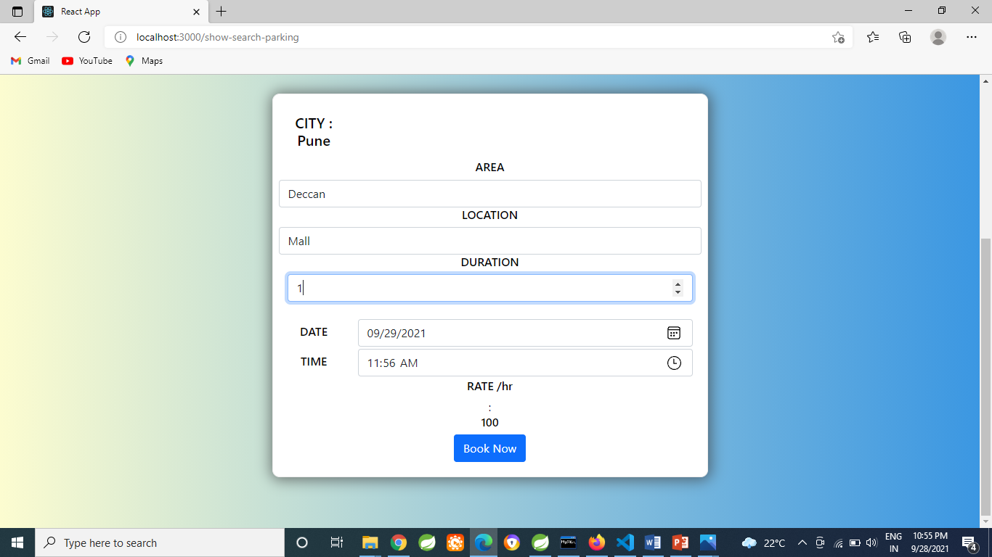
User Can Book Parking Space

Slide 13
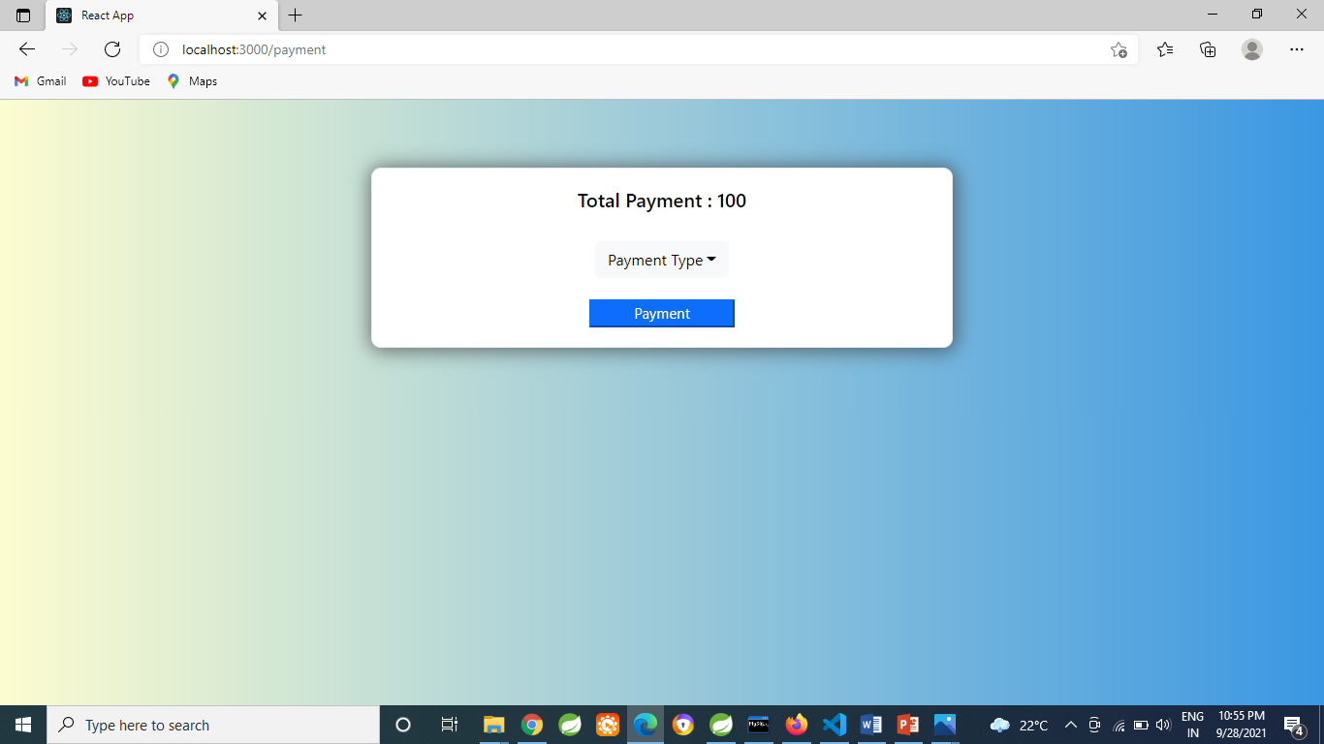

Slide 14
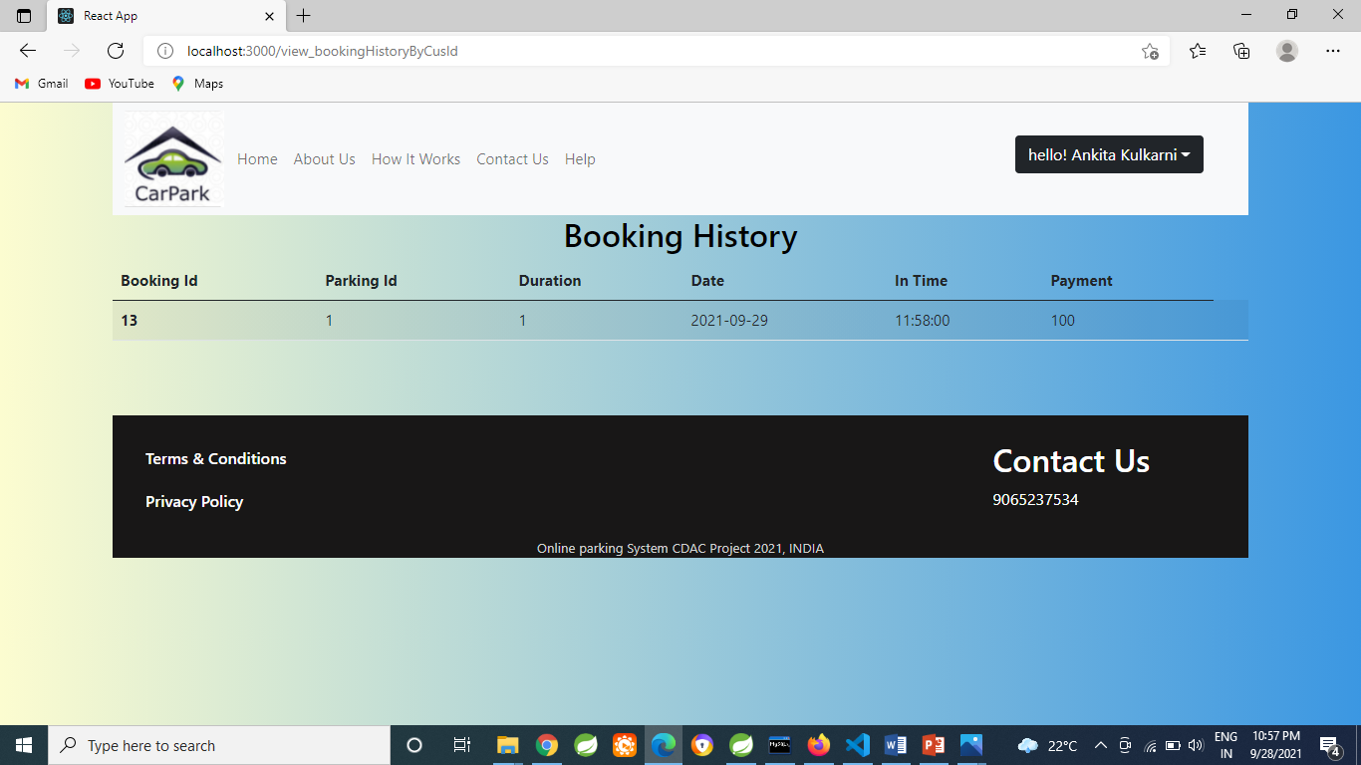
User can see Booking History

Slide 15
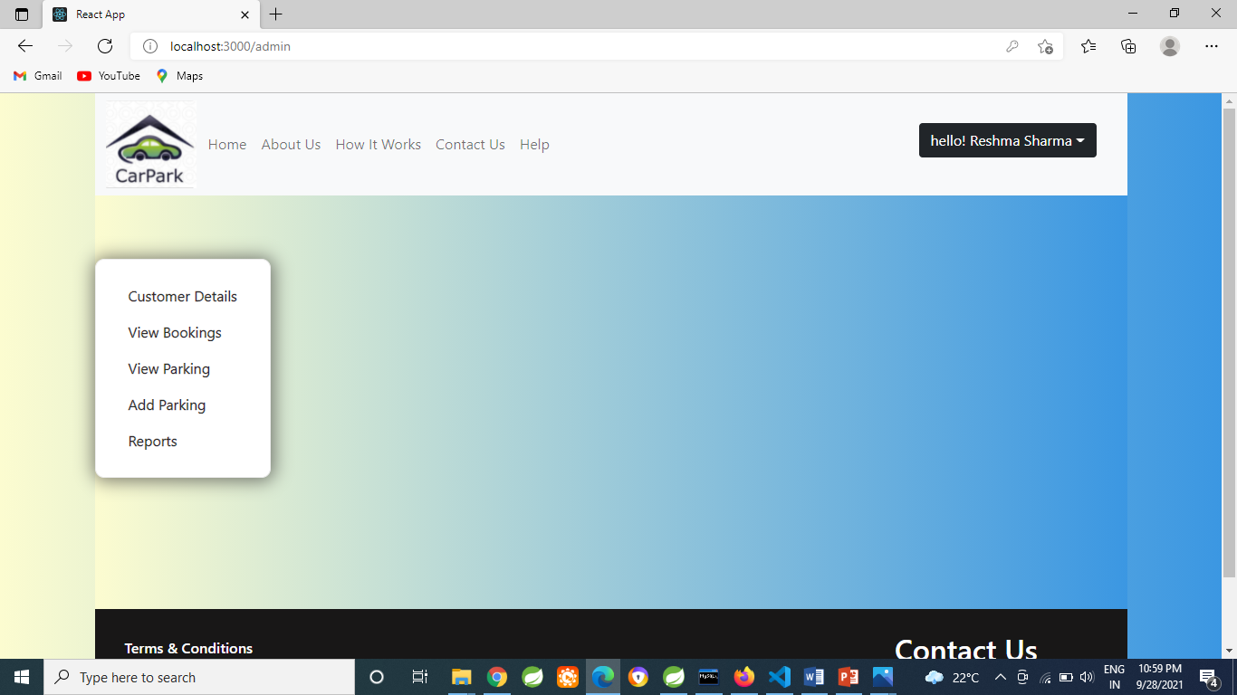
Login As a Admin

Slide 16
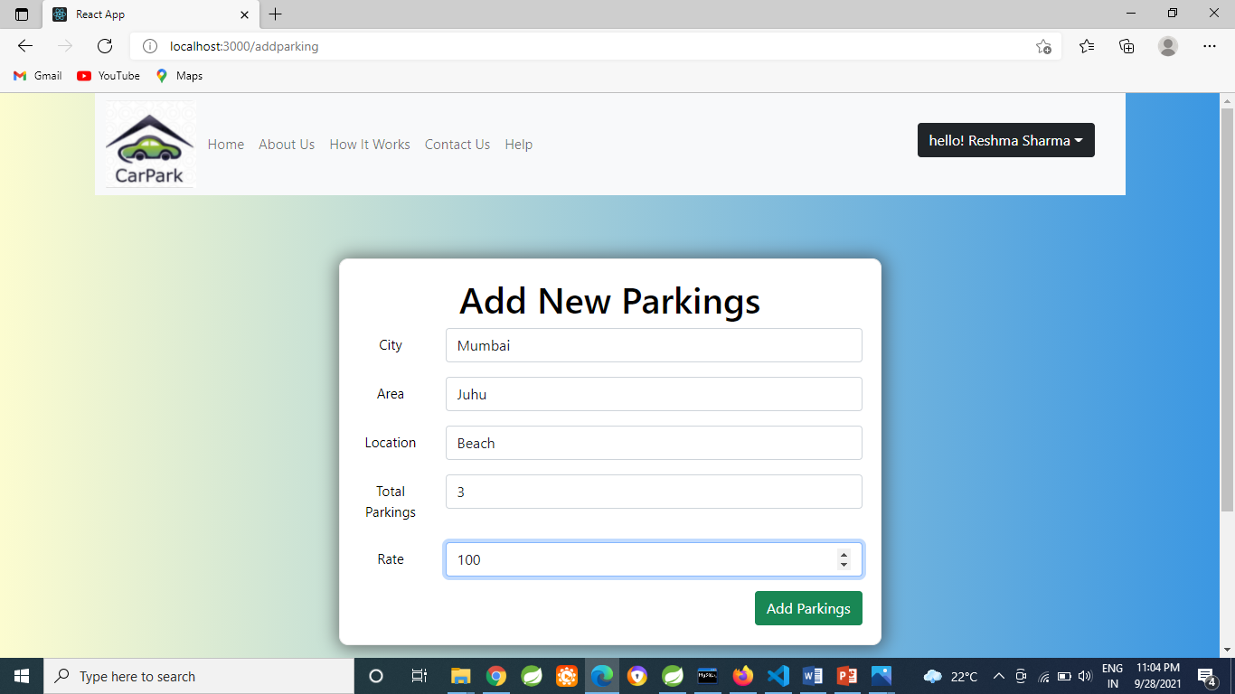
Admin Can Add New Parking

Slide 17
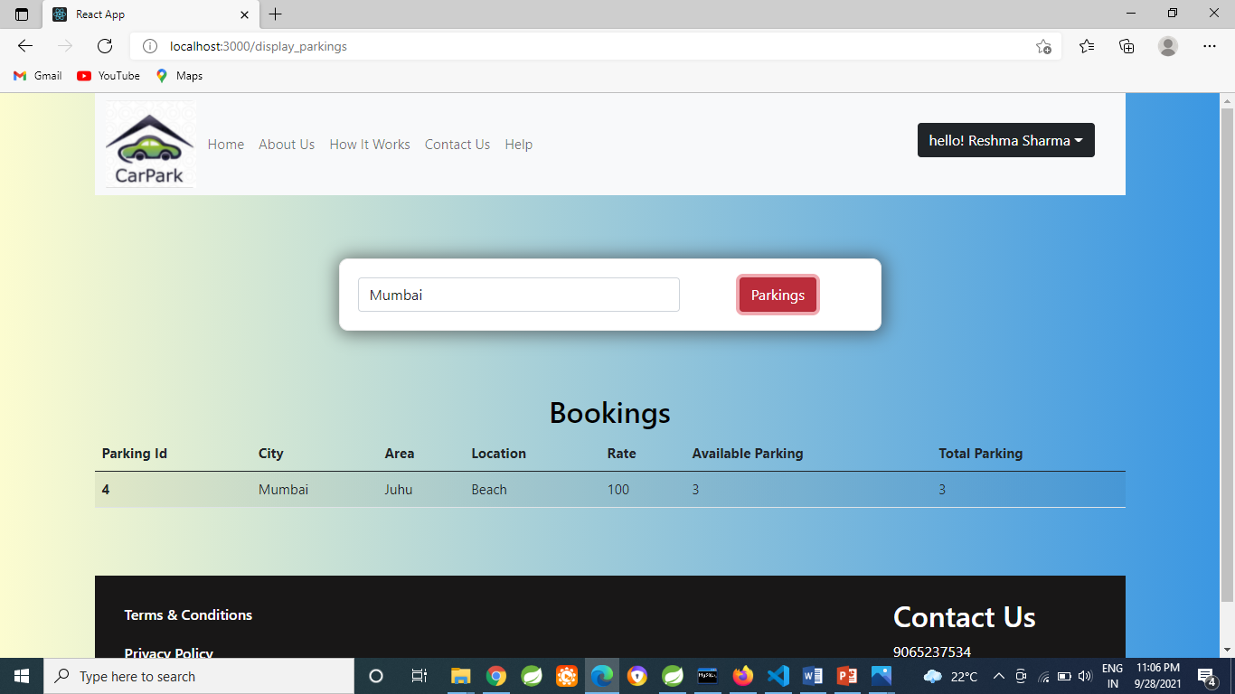
Display Parking

Slide 18
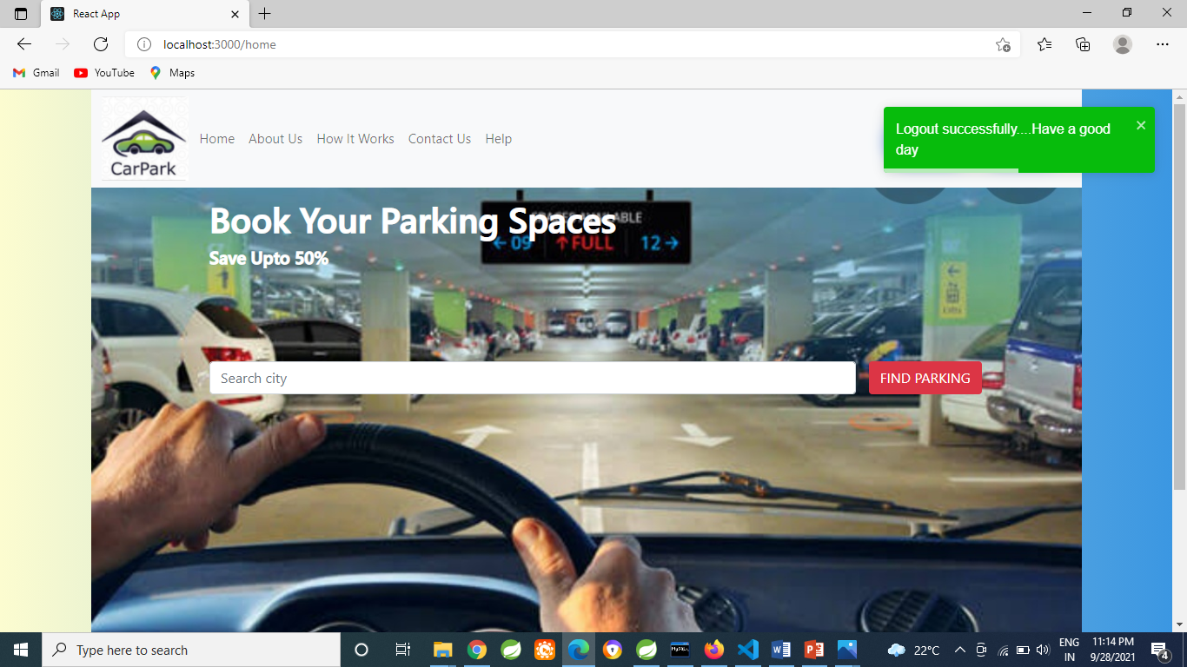
Logout of Admin

Slide 19
Advantages of System
User can view various parking spaces and select specific area
of their choice
It saves user time in search of parking space available in
specific area.
Disadvantages of System
It requires Internet connection

Slide 20
Conclusion
The difficulty of searching available parking spaces
has been completely eliminated by reserving Parking
spaces via proposed system
It saves user time in search of parking space available in
specific area.

Slide 21
Thank You

